Slide 1
Automatic Upload of Electronic Holdings
ProQuest Ebook Central
Yoel Kortick
Senior Librarian

Slide 2
Agenda
Introduction
The setup
The update from ProQuest
The update from ProQuest - example of deleted portfolios
The update from ProQuest - example of updated portfolios
The update from ProQuest - example of activated portfolios
Missing portfolios status information
Community Zone Updates Task List
2

Slide 3
Introduction

Slide 4
Introduction
In addition to this presentation see also Upload Electronic Holdings from ProQuest Ebook Central for Subscriptions/Owned/DDA
ProQuest Ebook Central Upload Electronic Holdings integration allows the institution to automatically manage (activate/deactivate) the electronic resources to which the institution has access via the ProQuest Ebook Central platform
The ProQuest Ebook Central Upload Electronic Holdings integration can identify which resources the institution has access to based on the institution’s Ebook Central site ID.
This service eliminates the need for human intervention when activating the electronic resources of the Ebook Central platform for any electronic title, whether it is part of a subscription, a PDA/DDA program, or individually owned/purchased titles.

Slide 5
Introduction
ProQuest Ebook Central Upload Electronic Holdings integration ensures that the institution’s institution-specific electronic holdings for ProQuest Ebook Central collection are up-to-date and reflect the institution’s purchase.
ProQuest Ebook Central Upload Electronic Holdings integration handles the following ProQuest Ebook Central titles:
  Owned – Ebook titles that were purchased as perpetual-access, single Ebook titles
  Subscription – Ebook titles that are part of a subscription (live or on trial)
  DDA – Ebook titles that are part of the ProQuest PDA/DDA (Patron Driven Acquisition/Demand Driven Acquisition) program

Slide 6
Introduction
The upload frequency for the Automatic Upload of Electronic Holdings for ProQuest Ebook Central is Daily
The Community Zone provides the following ProQuest Ebook Central electronic collection:
  Ebook Central Perpetual, DDA and Subscription Titles (Community Zone Collection ID = 614330000000000002)

Slide 7
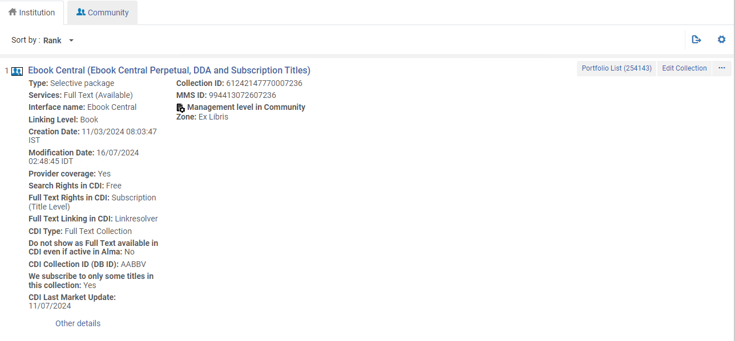
Introduction
To support this capability, the institution must activate the electronic collection “Ebook Central Perpetual, DDA and Subscription Titles” (Community Zone Collection ID 614330000000000002) from the Community Zone
Active collection linked to CZ

Slide 8
The setup

Slide 9
The setup
These are the four steps of the setup:
  Obtain from ProQuest an Ebook-Central site ID.
  Ensure that the electronic collection “Ebook Central Perpetual, DDA and Subscription Titles” (Community Zone Collection ID 614330000000000002) is activated in the institution.
  Add an integration profile of type “Upload Electronic Holdings” and choose “ProQuest Ebook Central” as the “Provider”.
  In the integration profile fill in the Ebook-Central site ID (which you received from ProQuest) and choose a scheduling option.

Slide 10
The setup
The second step is to ensure that the electronic collection “Ebook Central Perpetual, DDA and Subscription Titles” (Community Zone Collection ID 614330000000000002) is activated in the institution. For example:
Active collection linked to CZ

Slide 11
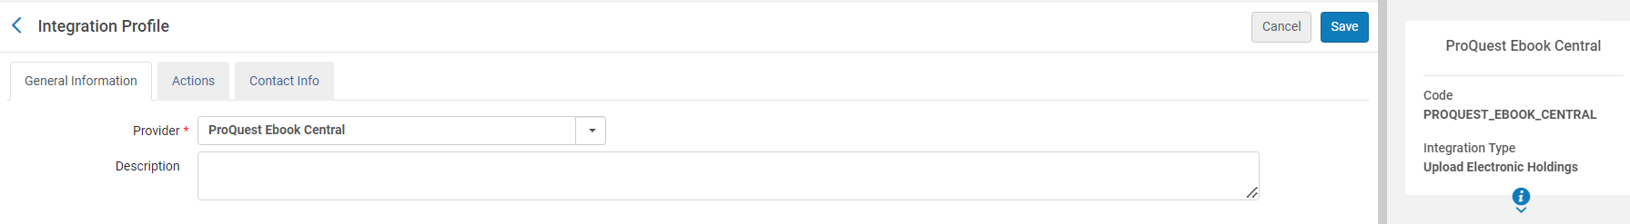
The setup
The third step is to add an integration profile of type “Upload Electronic Holdings” and choose “ProQuest Ebook Central” as the “Provider”.
This is done from the “Profile List” page at “Configuration > General > External Systems > Integration Profiles”

Slide 12
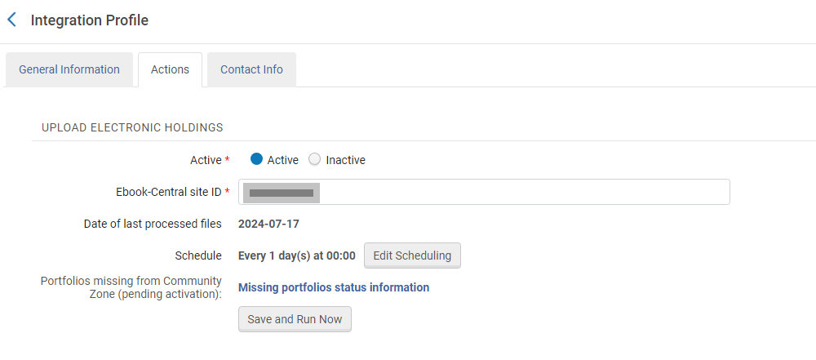
The setup
The fourth step is to fill in the Ebook-Central site ID (which you received from ProQuest) and choose a scheduling option.

Slide 13
The update from ProQuest

Slide 14
The update from ProQuest
The job “Upload Electronic Holdings” for vendor ProQuest will run as scheduled. In this case, every day at 00:00

Slide 15
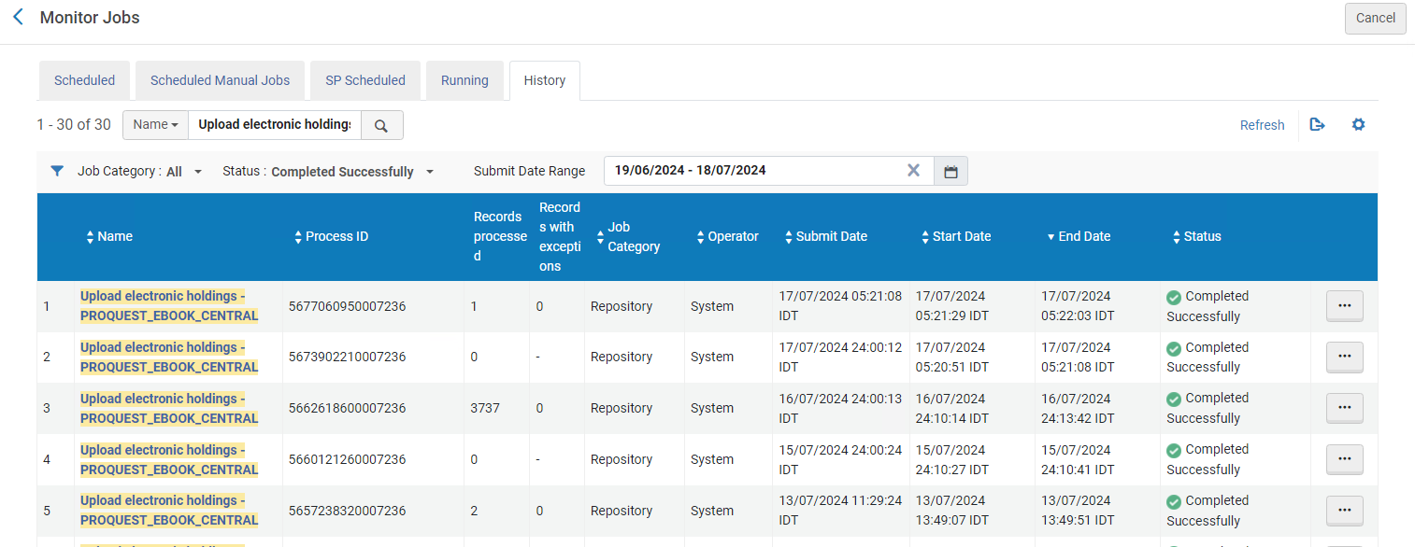
The update from ProQuest
Here from the “Monitor Jobs” we have filtered all by all jobs “Upload electronic holdings - PROQUEST_EBOOK_CENTRAL” completed successfully for the last 30 days.

Slide 16
The update from ProQuest - example of deleted portfolios

Slide 17
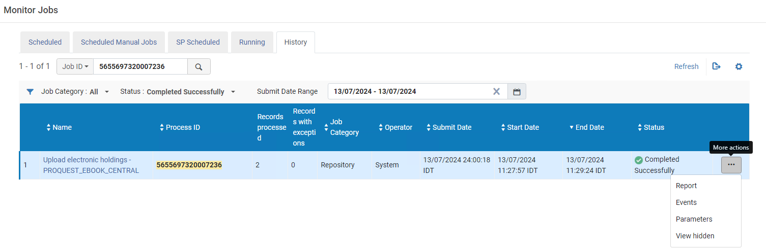
The update from ProQuest – example of deleted portfolios
Let’s take a look at the report for the job run on July 13, 2024, process ID 5655697320007236

Slide 18
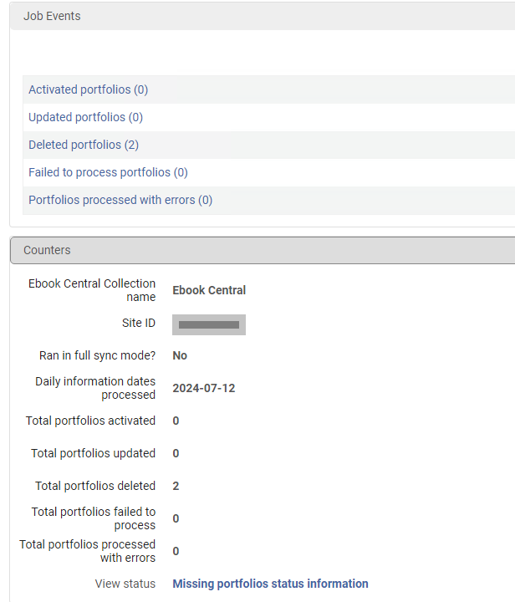
The update from ProQuest – example of deleted portfolios
2 portfolios were deleted
We will click this link

Slide 19
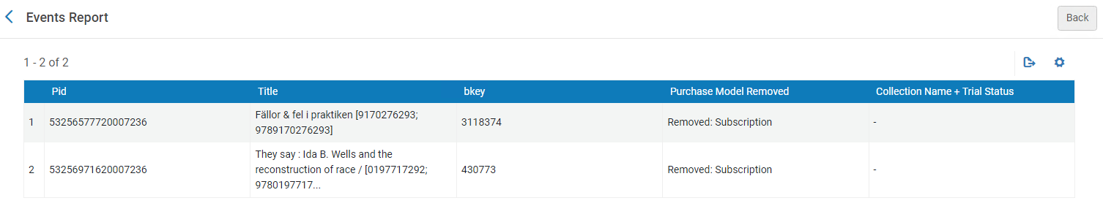
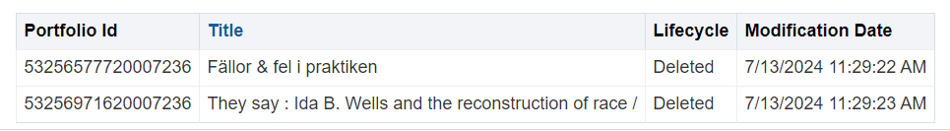
The update from ProQuest – example of deleted portfolios
In the report we can see which portfolios were deleted
And in Alma Analytics we see that they were in fact deleted on July 13, 2024.

Slide 20
The update from ProQuest - example of updated portfolios

Slide 21
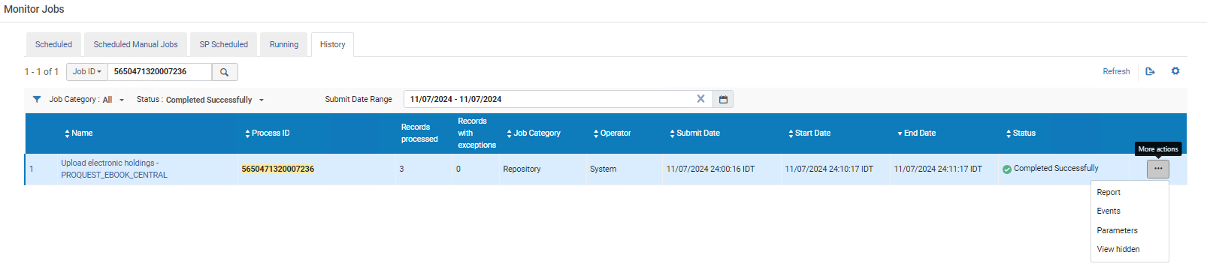
The update from ProQuest – example of updated portfolios
Let’s take a look at the report for the job run on July 11, 2024, process ID 5650471320007236

Slide 22
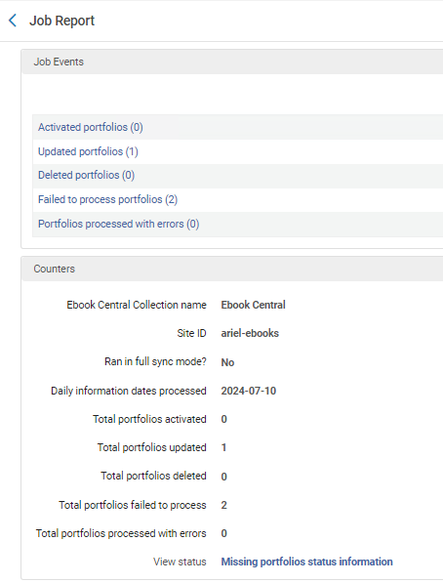
The update from ProQuest – example of updated portfolios
1 portfolio was updated
We will click this link

Slide 23
The update from ProQuest – example of updated portfolios
In the report we can see which portfolios were updated. Portfolio ID 53257317730007236 was updated.

Slide 24
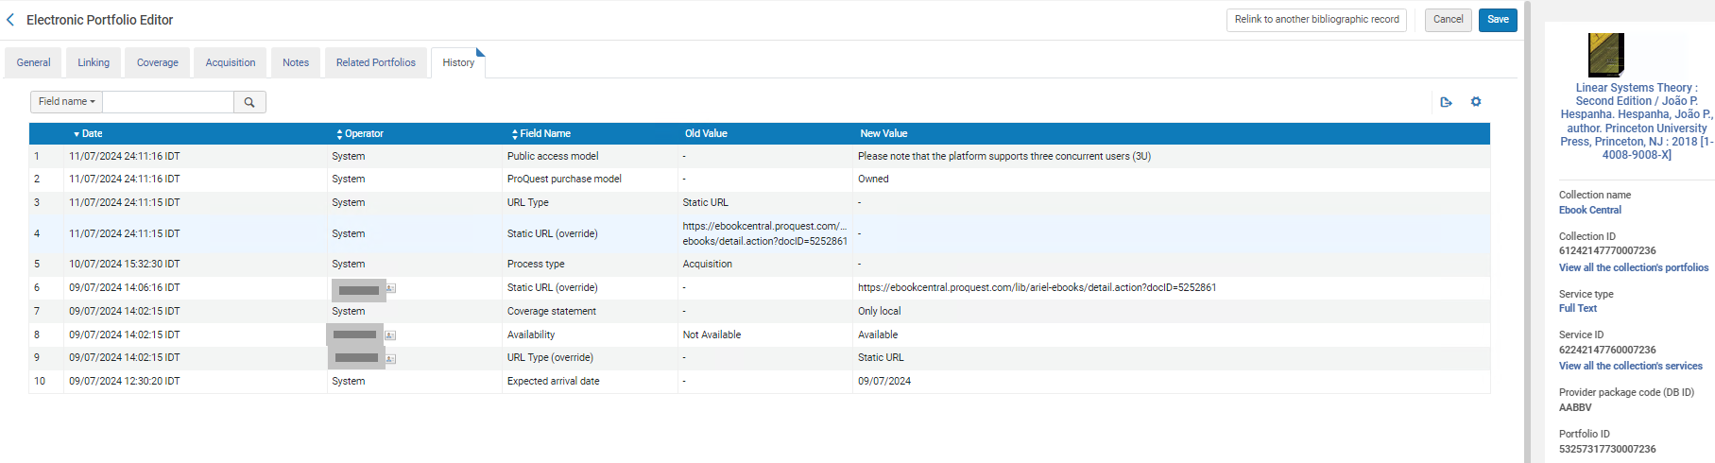
The update from ProQuest – example of updated portfolios
In Alma we can see (in the “History” tab of the Electronic Portfolio Editor) that the electronic portfolio with ID 53257317730007236 was updated on July 11, 2024 by “System” (The Upload Electronic Holdings” job).

Slide 25
The update from ProQuest - example of activated portfolios

Slide 26
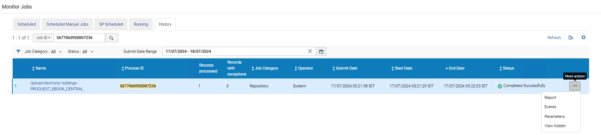
The update from ProQuest – example of activated portfolios
Let’s take a look at the report for the job run on July 17, 2024, process ID 5677060950007236

Slide 27
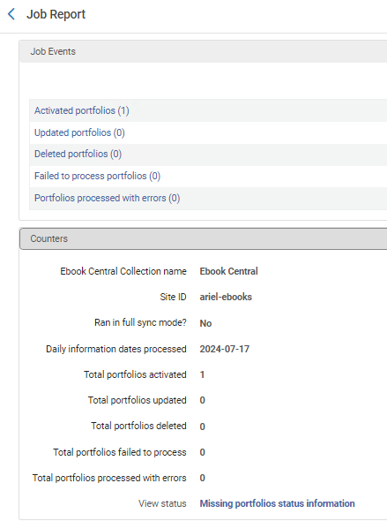
The update from ProQuest – example of activated portfolios
1 portfolio was activated
We will click this link

Slide 28
The update from ProQuest – example of activated portfolios
In the report we can see which portfolios were activated. Portfolio ID 53257910210007236 was activated.

Slide 29
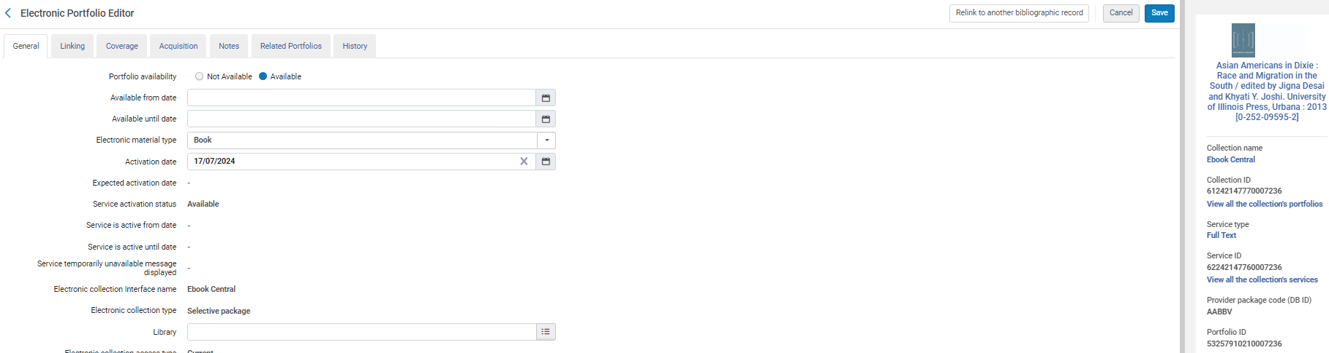
The update from ProQuest – example of activated portfolios
In Alma we can see (in the “General” tab of the Electronic Portfolio Editor) that the electronic portfolio with ID 53257910210007236 was activated on July 17, 2024.

Slide 30
Missing portfolios status information

Slide 31
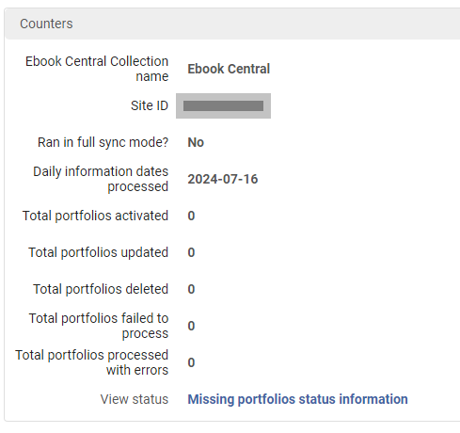
Missing portfolios status information
The report also contains a link to the “Missing portfolios status information”

Slide 32
Missing portfolios status information
Regarding the “Missing portfolios status information” report:
In cases where the Upload Electronic Holdings process ran and was not able to activate the relevant portfolios from the Community Zone, Alma will keep trying to see if these titles were added to the Community Zone in order to activate them for the institution.
The "Last update date” is the last date when the profile tried to activate the portfolios from the CZ.

Slide 33
Missing portfolios status information
The link “Missing portfolios status information” provides a link to the file “Missing portfolios status information”.
This file identifies portfolios which previously or currently were missing from the Community Zone, and when they become available in the Community Zone get activated via Alma synchronization job.
The "Last update date” is the last date when the integration profile tried to activate the portfolios from the CZ.
For details, see Portfolios missing from the Community Zone.

Slide 34
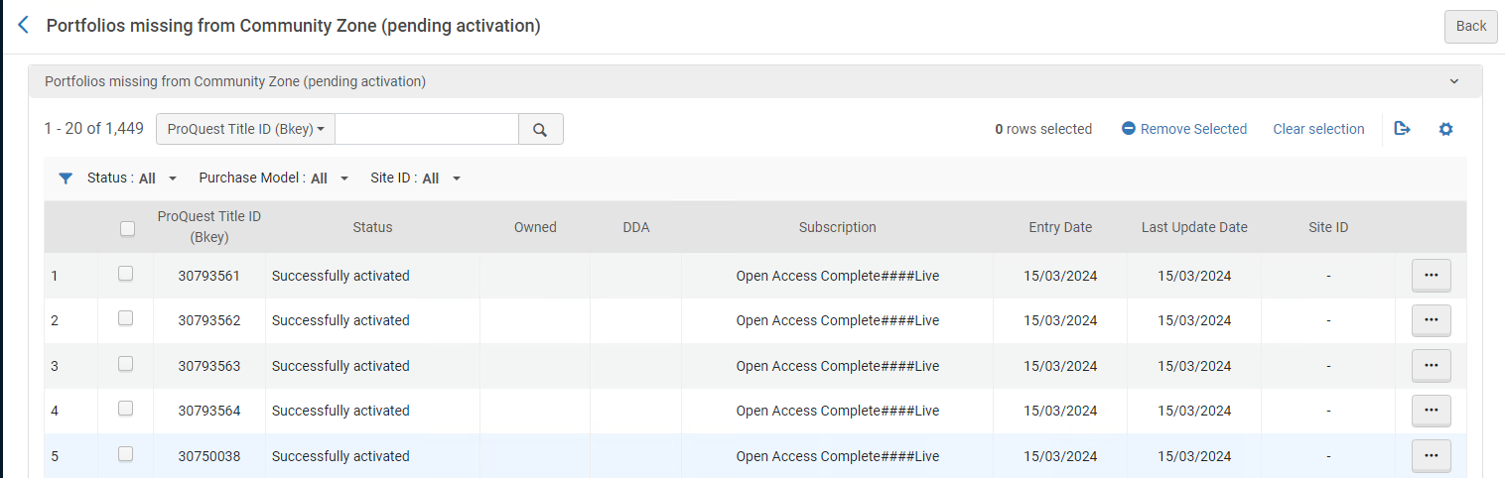
Missing portfolios status information
After clicking the “Missing portfolios status information” link this is what we see:

Slide 35
Community Zone Updates Task List

Slide 36
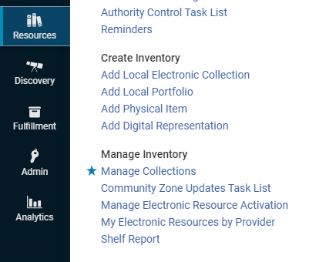
Community Zone Updates Task List
All changes to the electronic collection can also be seen via the Community Zone Updates Task List

Slide 37
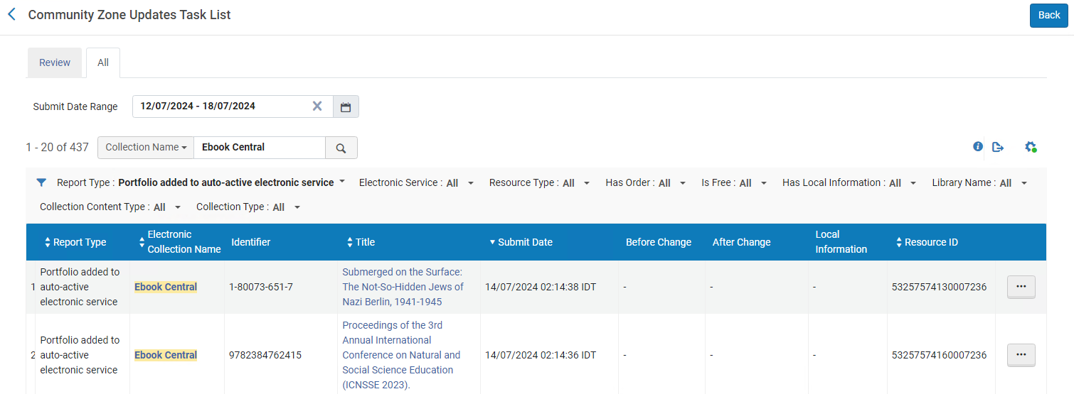
Community Zone Updates Task List
Here we have filtered by Electronic Collection Name “Ebook Central” and report type “Portfolio added to auto-active electronic service”
We will look at Resource ID 53257574160007236 title “Proceedings of the 3rd Annual International Conference on Natural …”

Slide 38
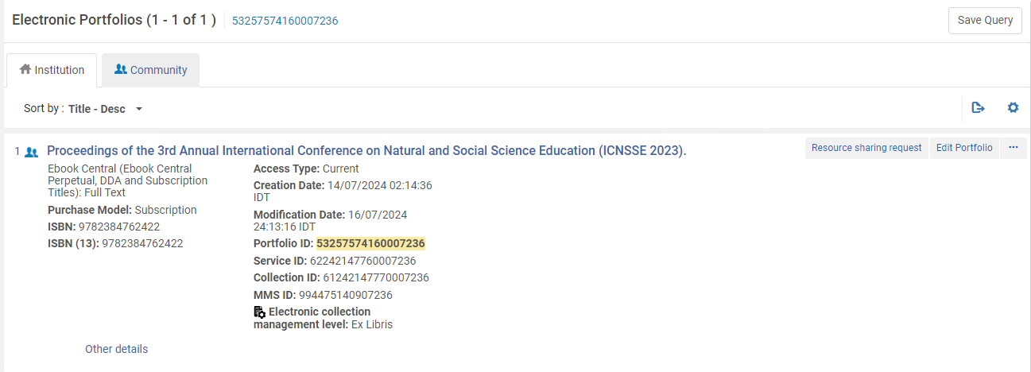
Community Zone Updates Task List
Here we see the resource in Alma in Electronic Collection Name “Ebook Central”

Slide 39
Summary

Slide 40
Summary
Via a simple setup the institution is able to automatically receive updates from ProQuest to update the holdings of the electronic resources.
Portfolios can be automatically updated, activated and deleted, and are specific to the purchase of the institution. We saw three specific examples in Alma where this occurred.
No manual work is needed.
This is a great time saver, replacing the need to get the files from the vendor, make sure they are in proper format, and manually load them to Alma

Slide 41
Thank You

